Slide 1
Innovative test solution
Provider
- Probe pin Datasheet -

Slide 2
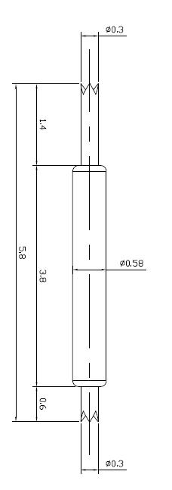
※ General POGO pin – 5.8mm / 0.65P
IVB-DCC-580-058-A223-00
Pitch | 0.65mm
Total Length | 5.8mm
Use Length | 5.0mm
Use Stroke | 0.8mm
Spring Force at Use Stroke | 25gf at 0.8mm Stroke
Operating Temperature | -40 to 125°C
DC Resistance | Under 100.0mΩ at 0.8mm stroke
Current Rating | 3A (Continuous)
Self Inductance | TBD
Bandwidth @ -1dB | TBD
Top Plunger | BeCu / Au
Bottom Plunger | BeCu / Au
Barrel | Phosphor bronze / Au
Spring | Music Wire/ Au
Insertion Life | 100,000 cycles at 0.8mm Stroke

Slide 3
Thank you.

